Slide 1
STC MBBF Booth with Scripts

Slide 2
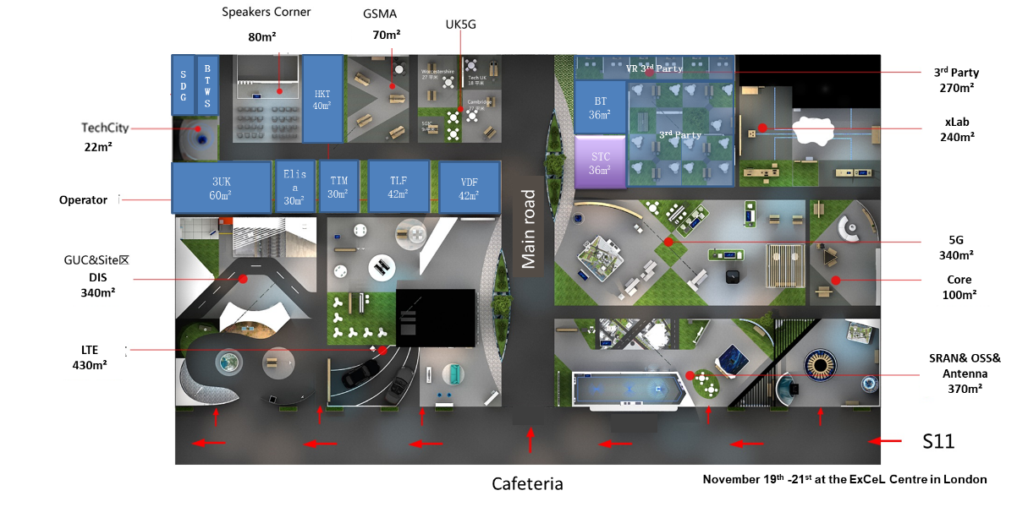
Overview of Operators’ Booths

Slide 3
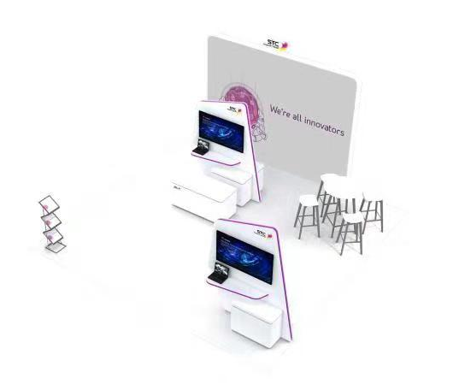
STC’s Booth Design
Background Board（Design by STC）
55’ Screen x 4
1xDesk + 4 Chairs
5G Use Cases Sandbox
Bookshelf(Brochure）
6*6=36m²

Slide 4
Booth Layout with Screen Messages
Main Road
leaflet Shelf
Screen 1: Branding Video
Screen 4
Screen 3
Screen 2: STC Hybrid MBB progress
5G Target Network
Solid Steps towards Leading 5G Network
Leveraging KSA User Experience Gradually
Shutdown 2G/3G to Simplify Network
5G Sandbox
Background Board
Path
Screen 3: Sandbox Interactive screen
5G Use Cases Video/ Flash
Repeated 5G Use case video
Screen 1
Screen2
Screen 4: STC 5G Use Cases Vision
How 5G is changing the market landscape
What is the 5G Enabled Digital Life

Slide 5

Screen 1: STC Branding Video
No Script Needed

Slide 6
Screen 2: STC’s Hybrid MBB Network Strategy
Main Road
leaflet Shelf
Screen 1: Branding Video
Screen 4
Screen 3
Screen 2: STC Hybrid MBB progress
5G Target Network
Solid Steps towards Leading 5G Network
Leveraging KSA User Experience Gradually
Shutdown 2G/3G to Simplify Network
5G Sandbox
Background Board
Path
Screen 3: Sandbox Interactive screen
5G Use Cases Video/ Flash
Repeated 5G Use case video
Screen 1
Screen2
Screen 4: STC 5G Use Cases Vision
How 5G is changing the market landscape
What is the 5G Enabled Digital Life

Slide 7
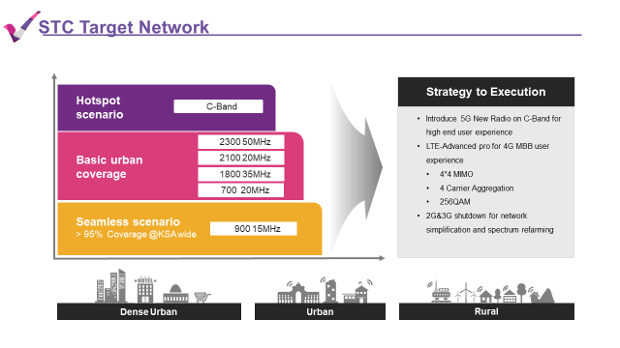
Screen 2-1: STC Target Network
For customer experience and digitalization, STC will build world class network. STC will using 900MHz for national wide coverage, using 700MHz, 1800MHz, 2100MHz and 2300MHz spectrums as basic urban coverage. And using C-band spectrum for hotspot requirements.
For the hotspot layer, STC introduce 5G tech to provide ultimate user experience. STC will introduce LTE-Advanced pro tech like 4*4 MIMO， carrier aggregation and high order modulation to LTE network. For the seamless coverage layer, STC will switch off 2G and 3G and refarming spectrum to LTE tech.

Slide 8
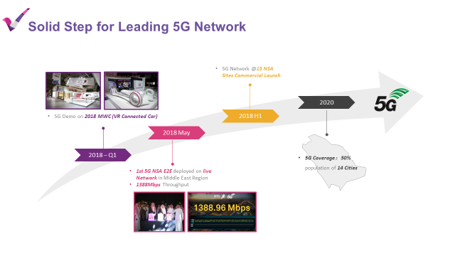
Screen 2-2: Solid Step for Leading 5G Network
STC aim to leading operator globally. STC start to research 5G tech from last year. STC take 5G demo of VR connected car to MWC 2018. Customer can experience the driverless car scenario of 5G era.
At the May 2018, STC announced 1st 5G NSA E2E network of ME has been built in KSA, on this ceremony, customer can experience 5G era services, like VR, 1.4Gbps throughput, etc.
Till the 2018H1, STC already built 15 5G commercial sites, and plan to cover 50% population in 14 cities in KSA.

Slide 9
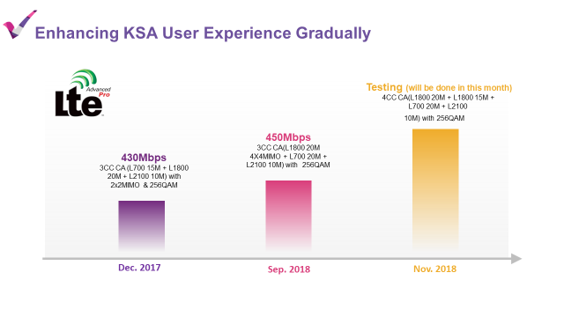
Screen 2-1: STC Target Network
Although 5G is the top priority thing of STC, LTE network is the important thing because of 5G terminal penetration. STC introduce LTE-Advanced pro tech to STC network like 4*4 MIMO, carrier aggregation and high order modulation, etc. STC test 3CC and 256QAM tech on STC live network and reach 430Mbps on Dec. 2017. and reach 450Mbps of 3cc,4*4MIMO and 256QAM on Sep. 2018.
As the latest result, STC reach XXXMbps by 4cc, 4*4MIMO and 256QAM on this month.

Slide 10
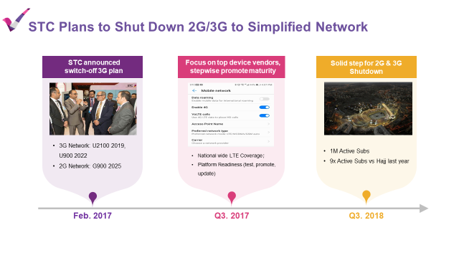
Screen 2-1: STC Target Network
STC allocate 900MHz to 2G and 3G RAT. STC announced to switch off 3G network before 2G on MWC 2017. STC plan to switch off U2100 on 2019, U900 on 2022 and G900 on 2025.
Based on this strategy, STC do the preparation on platform and network and focus on top device vendors. On the network side, STC plan to deploy nation wide L700 network to carry VoLTE service. On the platform side, STC do the testing of the software system and do promotion and upgrading of the terminals.
Based on these activities, STC realize 9x active subs on 2018 Hajj compare to last year.

Slide 11
Booth Layout with Screen Messages
Main Road
leaflet Shelf
Screen 1: Branding Video
Screen 4
Screen 3
Screen 2: STC Hybrid MBB progress
5G Target Network
Solid Steps towards Leading 5G Network
Leveraging KSA User Experience Gradually
Shutdown 2G/3G to Simplify Network
5G Sandbox
Background Board
Path
Screen 3: Sandbox Interactive screen
5G Use Cases Video/ Flash
Repeated 5G Use case video
Screen 1
Screen2
Screen 4: STC 5G Use Cases Vision
How 5G is changing the market landscape
What is the 5G Enabled Digital Life

Slide 12
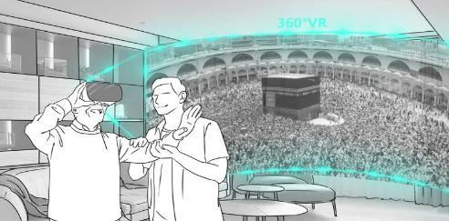
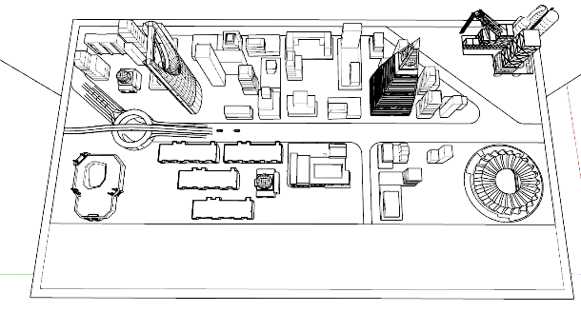
Sandbox + Screen 3: use cases in KSA typical scenarios
Illustration Screen will show the selected use case video to demonstrate what it is
Sandbox with light effect to show where the use case is likely to happen. For example: Kingdom Tower represents offices, where Holo communication is likely to happen.
Menu: Scenario selection Area （10 use cases）: select by touching the use case picture

Slide 13
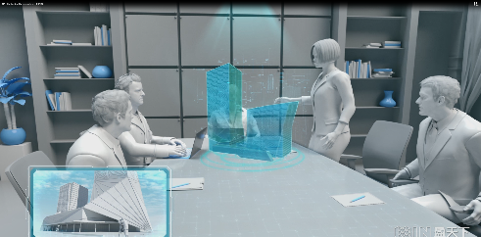
Scenario 1: Holo Collaboration
Video Script:
Physical distance will not be the barrier of communication anymore. With Holo Collaboration’s help, every corner of the world can be brought to you with all details of information just like you are standing by it. More intuitive and immersive collaborations will significantly enhance the enterprise remote collaboration efficiencies.
Key Points
Large Bandwidth：
Video conference is common now and we all prefer it over voice only calls
Imagine now the remote conference is 360 degree with all information, just like all sci-fi movies scenes
Anywhere：
Fiber can support office side bandwidth, but what if the holo video is collected at somewhere without fixed coverage? Somewhere remote?
Only 5G can ensure the service everywhere

Slide 14
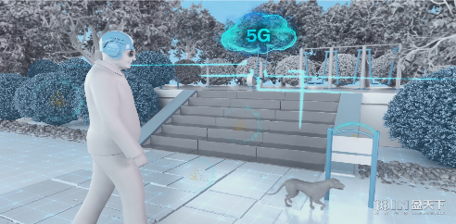
Scenario 2: Smart Helmet for Blind People
Video Script:
5G connects smart devices with cloud seamlessly. With the Smart helmet’s help, the visually impaired people can finally enjoy the world with the audio guide from the helmet.
Key Points
Large Bandwidth：
To ensure the safety of user, the helmet has to collect as rich info as possible and upload to the cloud to be processed and then feed back to the user via audio guidance
Low Latency:
There is no point to use the helmet if it reminds user there are steps 5 meters ahead with 10 seconds latency. It requires “real time”
Anywhere：
People should not be limited to the fiber covered area only.

Slide 15
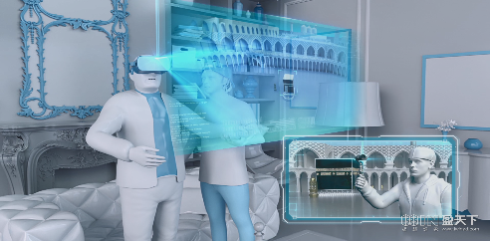
Scenario 3: VR Tour
Video Script:
Feeling regretted that some places you cannot go with your loved ones? Now your family and friends can share everything around them with you in real time just like you are together with them.
Key Points
Large Bandwidth：
Currently LTE cannot support 360 video chat due to the limitation of upload bandwidth. Only 5G can enable the VR live chat for end users
Anywhere：
Most of the famous sites that people wants to visit do not have fiber coverage. Only 5G can bridge the connection gap for attractive applications

Slide 16
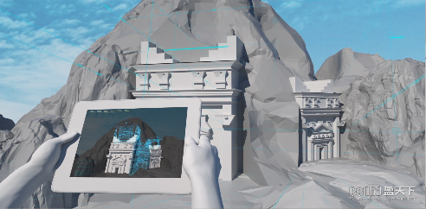
Scenario 4: AR Enhanced Tour
Video Script:
Wondering what the world look like thousands years ago? Cloud AR technology bridges the virtual world into our physical world. All you need to do is just have a peak through your mobile screen.
Key Points
Large Bandwidth：
AR concept is well known today and limitless imaginations are built on it. One condition for AR is the uplink bandwidth with powerful cloud computing.
Anywhere：
Most of the famous sites that people wants to visit do not have fiber coverage. Only 5G can bridge the connection gap for attractive applications

Slide 17
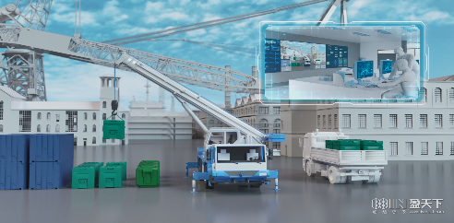
Scenario 5: Remote Precise Operation
Video Script:
Say goodbye to the high climbing, say goodbye to the huge machinery contacts, say goodbye to the harmful chemical. Ultra safety will be brought to all heavy industries and hazardous operations with the remote operation technologies.
Key Points
Large Bandwidth：
People trust their eyes. For remote control, the most intuitive way is to see what is happening remotely. Only 5G ensures the quality of uplink video
Low Latency：
Heavy machinery requires precise operation, low latency is a must if remote control is to be adopted
Massive Machine Connection：
What will happen if we put sensors everywhere? We can monitor everything! Massive machinery cannot be monitored just by looking at it. Previously, either the connections were too expensive, or technically not possible. 5G is here to change the game.

Slide 18

Scenario 6: On Demand Video Surveillance
Video Script:
Most of critical assets are in remote areas that is difficult and very expensive to maintain. With 5G UVA’s help, 10 times higher efficiencies are easily obtained with significantly lower cost.
Key Points
Large Bandwidth：
How to monitor the places where there is not cable connection? 5G is the only solution if you want to have the high quality video, especially to monitor from Drones
Low Latency：
To remotely control the drone, low latency is a must to guarantee the safety of drone and also the machineries that been monitored

Slide 19
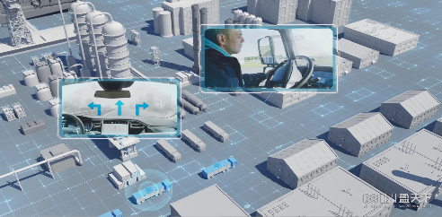
Scenario 7: Platooning
Video Script:
Hoping the world logistic system can be faster, safer, and in the same time more environmental friendly? Truck Platooning is one of the quick win solution. With the 5G connection among trucks, one driver can manage multiple trucks with greater efficiency, safety, and less energy consumptions.
Key Points
Low Latency：
Truck platoons will stay close to each other to reach the maxi energy efficiency. All trucks’ decisions has to be made within milli seconds to ensure the safety of all platoon and the surroundings.
Massive Machine Connection：
To sense everything around and talking with each other, massive amount of sensors are needed to be built in the trucks and even the objects along the routes
Large Bandwidth：
To support the massive sensors communication including video processing, the uplink bandwidth can only be supported by 5G

Slide 20
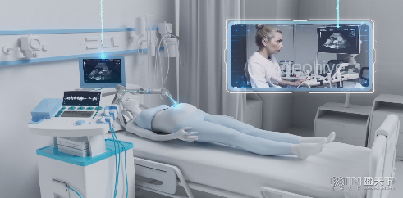
Scenario 8: Remote Diagnostic
Video Script:
The best medical resource has always been scarce due to the geographical uneven distributions. With remote medical, people can enjoy the world class medical consultation, and even treatment in the future, without traveling, squeezing and queuing in the big institutions.
Key Points
Low Latency：
It is the medical equipment we are referring to, no one can bear the risk of precision compromise due to latency
Large Bandwidth：
No one likes the code feeling of dealing with machines, especially in hospital. Video consultation will need the uplink large bandwidth
Complex medical data need the large uplink bandwidth to be transferred to doctors to ensure the consultation qualities

Slide 21

Scenario 9: Drone Emergency Delivery
Video Script:
In case of emergency, time is life. With 5G UVA precise navigation, the first aid can be delivered to the needs with significantly shortened time. Professional consultation can also be delivered along with the drone via real time HD video communications.
Key Points
Low Latency：
In order to control the drone to fly to the needed area precisely, safely, and quickly, the latency on remote control has to be low
Large Bandwidth：
Live HD video consultation is a must to provide doctors the situation information

Slide 22
Scenario 10: Auto Driving
Video Script:
Driving will not be mandatory anymore. 5G enables the sensing and computing in real time and the cloud will take you safely to your destinations. You will be enjoying the journey just like sitting in your living room.
Key Points
Low Latency：
Will you sit in a car that takes 2 meters to break? The key is low latency to ensure the immediate response for your vehicle to react within milli seconds
Large Bandwidth：
To make your car similar as your living room entertainment center, binging fiber connection to your car is not possible. 5G is the only solution
Massive Machine connections：
You want to make sure every piece of your car is functioning properly. 5G enables the car manufactures to put hundreds or even thousands of sensors to your car and monitoring them in real time

Slide 23
Screen 2: STC’s Hybrid MBB Network Strategy
Main Road
leaflet Shelf
Screen 1: Branding Video
Screen 4
Screen 3
Screen 2: STC Hybrid MBB progress
5G Target Network
Solid Steps towards Leading 5G Network
Leveraging KSA User Experience Gradually
Shutdown 2G/3G to Simplify Network
5G Sandbox
Background Board
Path
Screen 3: Sandbox Interactive screen
5G Use Cases Video/ Flash
Repeated 5G Use case video
Screen2
Screen 1
Screen 4: STC 5G Use Cases Vision
How 5G is changing the market landscape
What is the 5G Enabled Digital Life

Slide 24
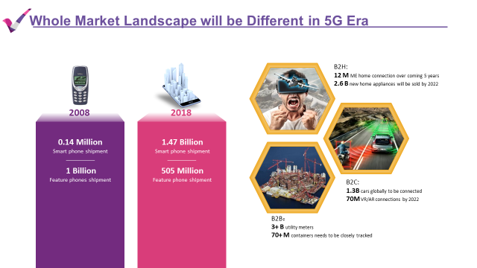
Screen 4 -1: Whole Market Landscape will be Different in 5G Era
Looking back, 10 year ago people were crazy about Nokia’s feature phones. Then suddenly iPhone was born, and now almost all our behavior are changed due to the power of smartphones. We believe the same change will happen with 5G’s presence. Over the past 10 years, number of phones doubled from 1 billion feature phones to 2 billion smartphones. No need for another 10 years, we already see the number of machine connections are exponentially booming.
The types of connection change and number of connection built, will definitely crate the deep impact for our life again.

Slide 25
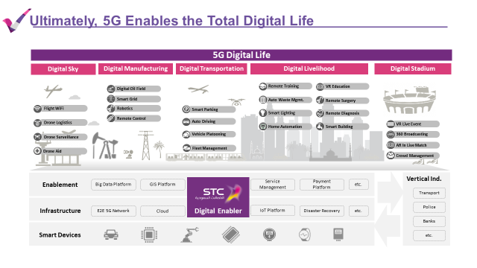
Screen 4-2: Ultimately, 5G Enables the Total Digital Life
Ultimately, STC is determined to contribute on building the digital life for KSA. Currently we can see many innovative use cases has been explored globally. Some are exploring the digital sky, some are improving the factories efficiencies, some are changing our way of entertainments. Overall speaking, all the creative ideas need to be built on one solid ICT foundation. It is STC’s obligation to create the ICT foundation for our nation.

Slide 26
Thank you

